Slide 1
The house of my dreams
Made presentation: ET-111 Savonin Maxim

Slide 2
objective
Design my dream home and tell about it

Slide 3
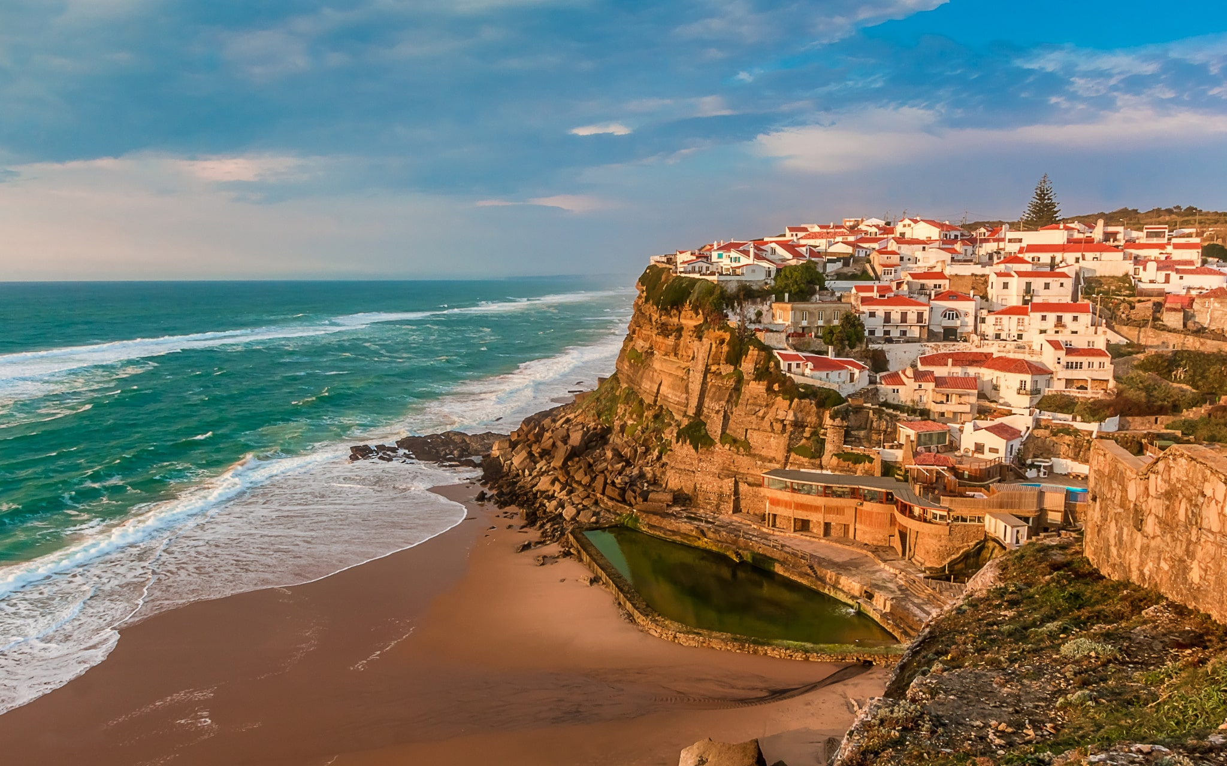
Place
I would like my house to be in Portugal. It is Beautiful country around Atlantic ocean. Also my aunt lives there.

Slide 4
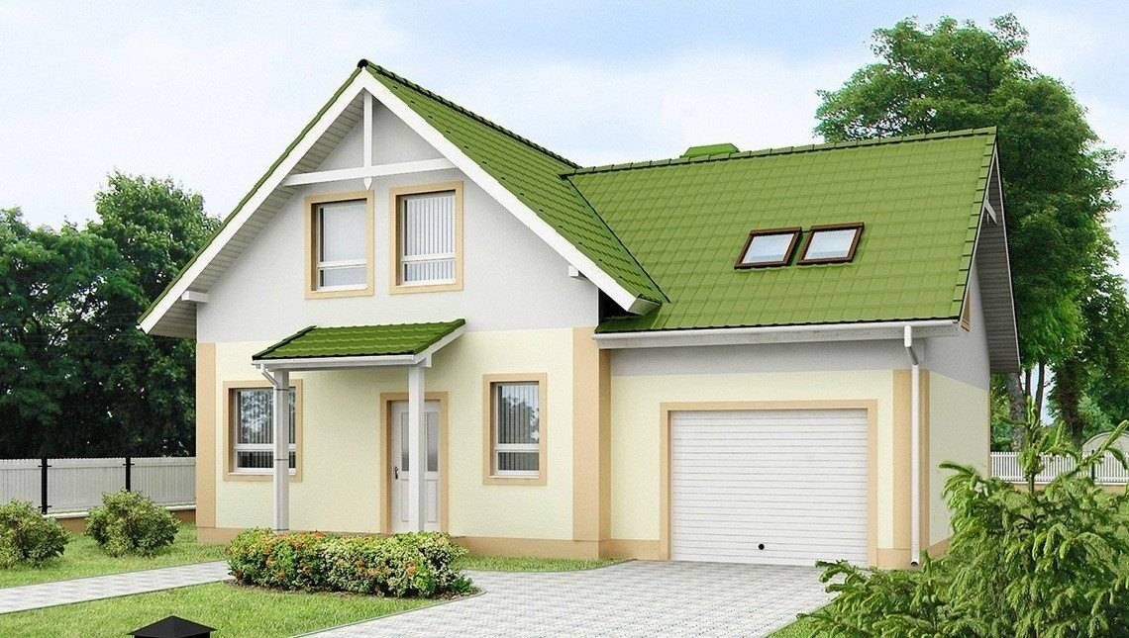
Appearance
It would be a two – storey house with lime roof. Paint it white or grey. It should have a garage and a lawn in the backyard.

Slide 5
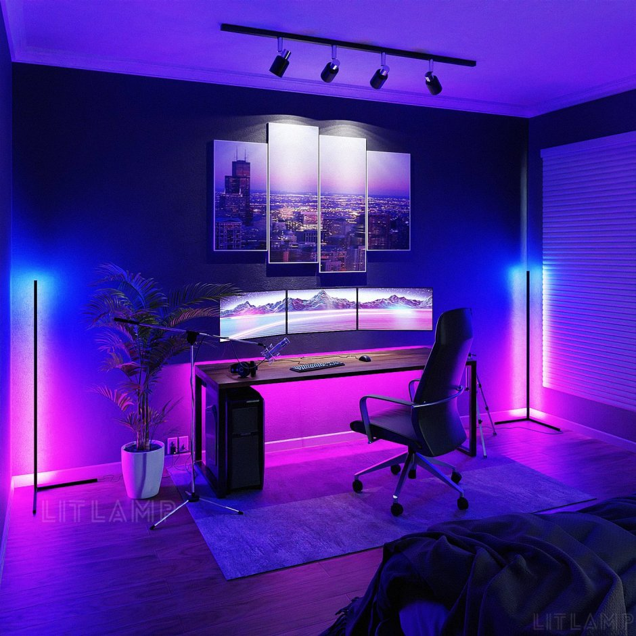
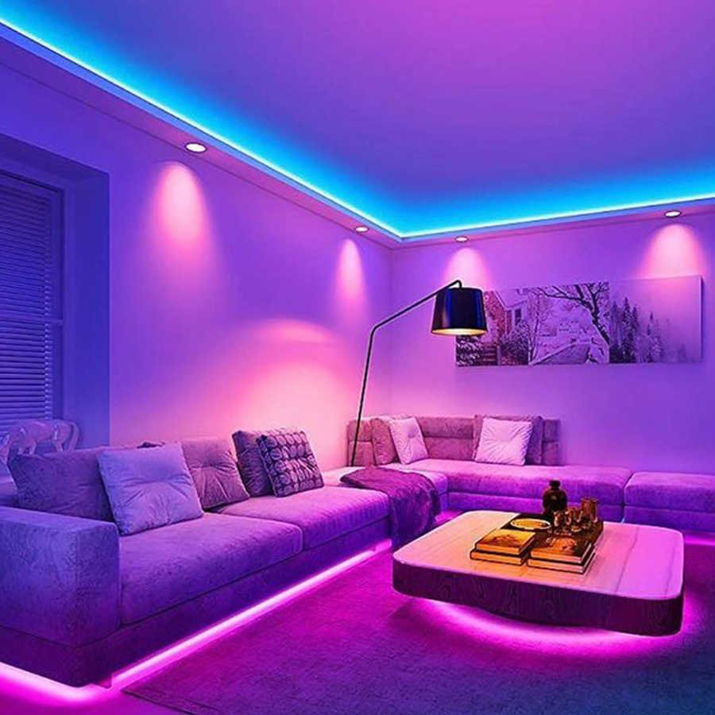
First Living room
In the living room will be situated big TV, sofa, coffee table, computer desk with PC and 2-3 armchair. This room will have special lamp and LEDs for interesting lighting.

Slide 6
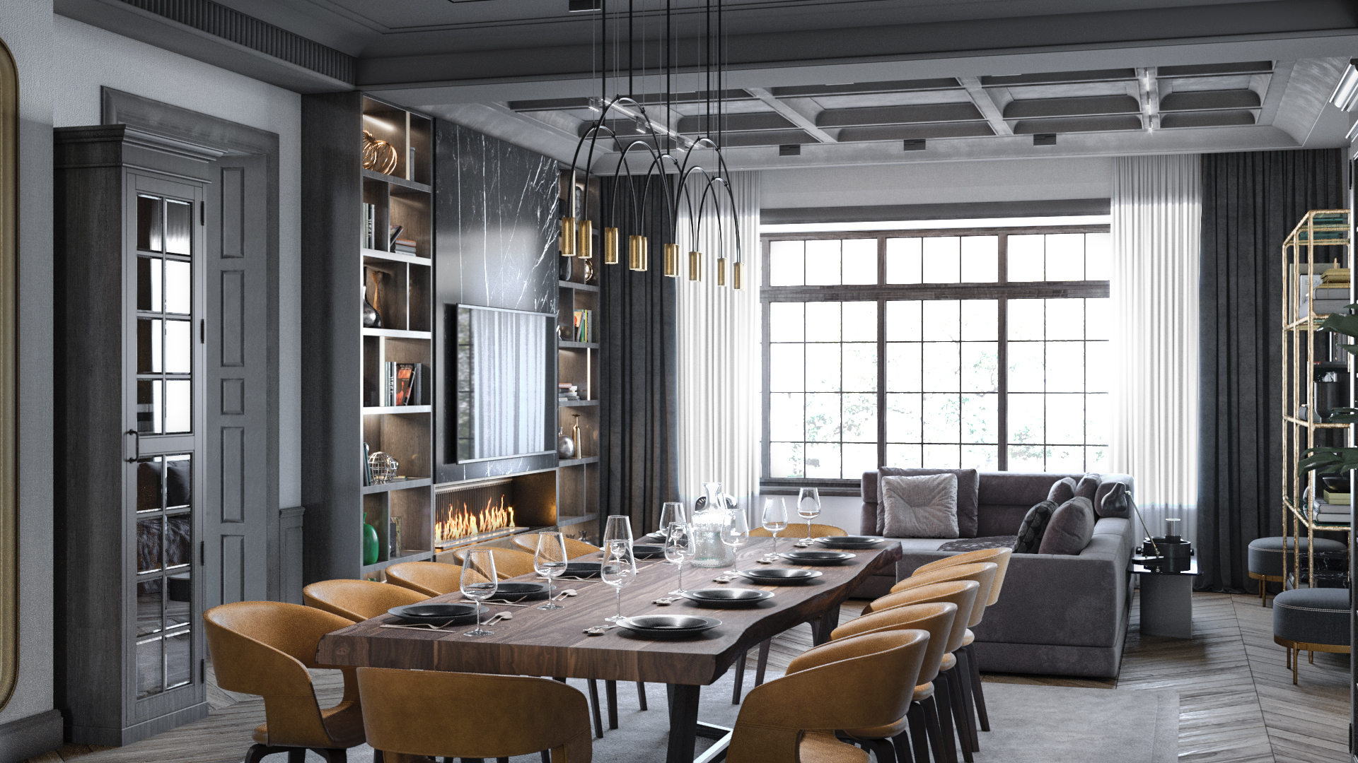
Second living room
Second living room for receiving guests for a holiday. It’s will have big table, more armchair, TV and sofa.

Slide 7
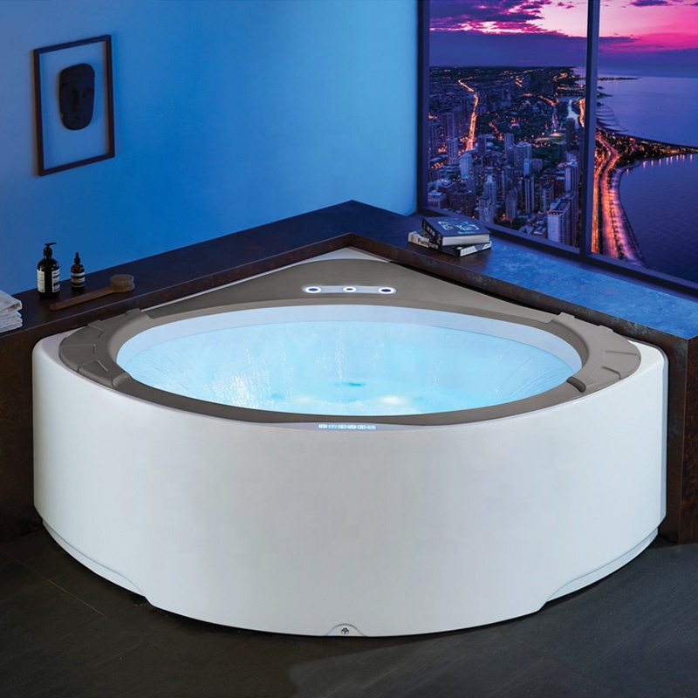
bathroom
There will definitely be a Jacuzzi in my house. And familiar to us sink, shower and toilet.

Slide 8
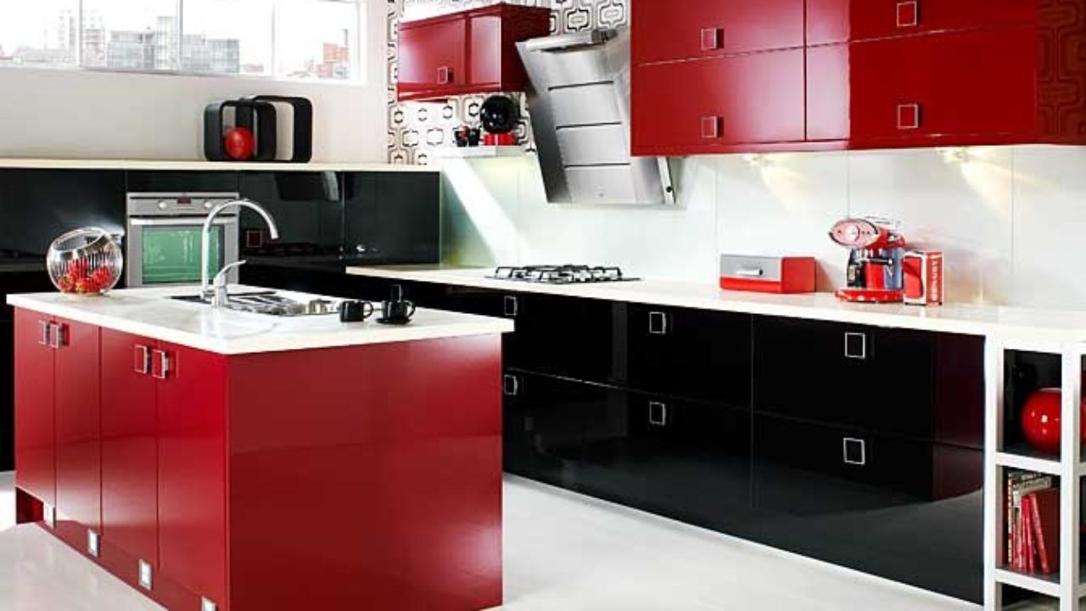
Kitchen
I don’t know much about kitchen appliances, but my kitchen will have fridge, cooker, microwave, a lots of cupboards and waffle iron.

Slide 9
conclusion
If will can do this house it will be a beautiful house

Slide 10
Questions
What color will the roof be?
How many armchair in first living room?
What color will the kitchen be?

Slide 11
Thank you for your attention!

